Slide 1
Payroll Gap Analysis – Manual vs Automated Payroll
August 2025
Objective:
Goal: To identify and compare inefficiencies in manual payroll vs automated payroll systems.
Outcome: Provide data-backed recommendations for payroll process improvement.
Modules Covered
Payroll Management
Employee Termination & Hiring
Department-wise Salary Analysis
Payment Mode Efficiency
Tax Deduction & Error Handling
Project by Gayathri S

Slide 2
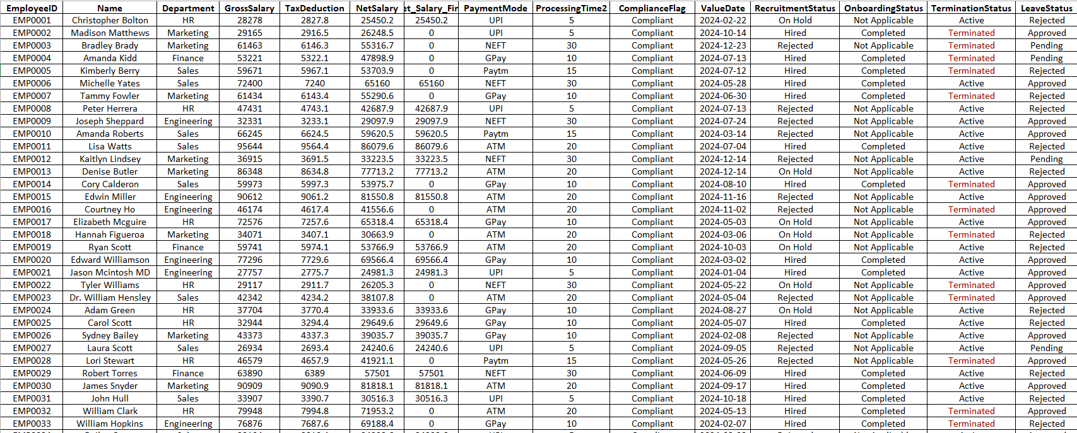
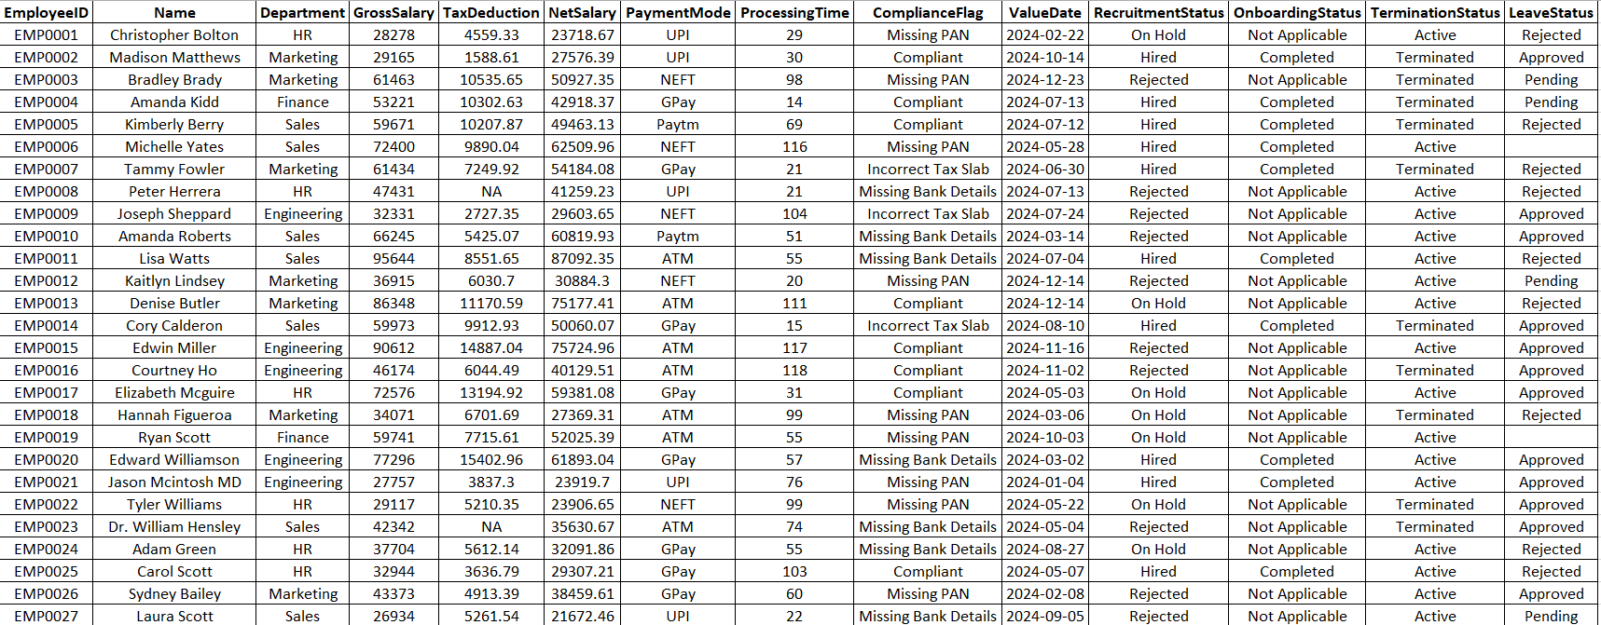
Dataset Creation I created two separate tables: Manual Payroll – 150 sample rows Automated Payroll – 150 sample rows Contains columns like: Employee ID, Name, Department, Net Salary, Processing Time, Payment Mode, Termination Status, Compliance Flag, Onboarding status, Recruitment Status
Automated Payroll Dataset
Manual Payroll Dataset
.

Slide 3
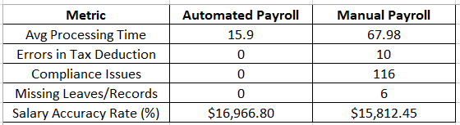
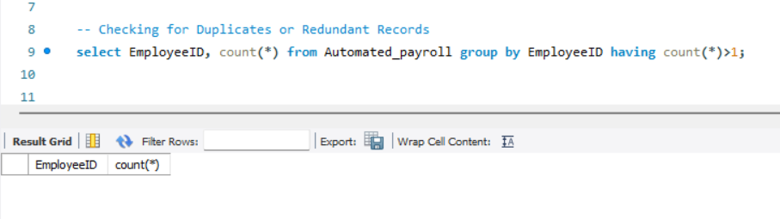
Comparison Summary – Manual vs Automated Payroll Table explains the key performance differences between manual and automated payroll processes:
Automated payroll process is faster and more accurate with zero errors in tax deduction, compliance and missing records — unlike the manual process which shows multiple issues
I wrote a few SQL queries to compare the automated and manual payroll datasets. No duplicate records were found

Slide 4
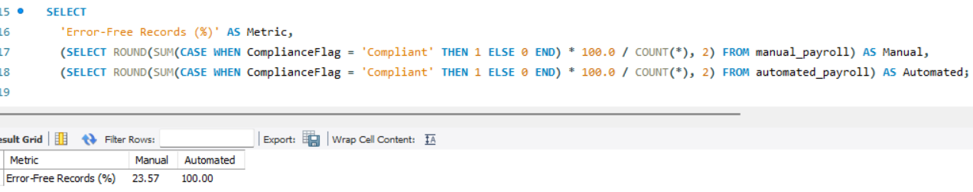
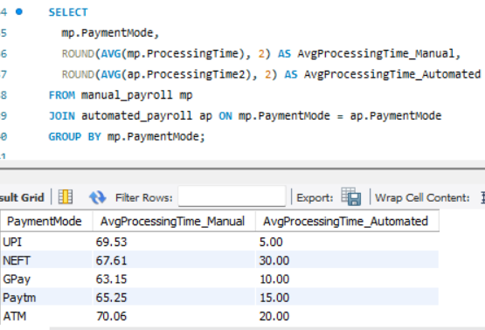
Automated payroll dataset is 100% error-free, while the manual payroll shows only 23.57% compliant records. inconsistency in manual payroll can lead to salary miscalculations, compliance issues.
This query compares the average processing time by payment mode between manual and automated payroll. Automated methods significantly reduce processing time across all payment types, improving overall efficiency.

Slide 5
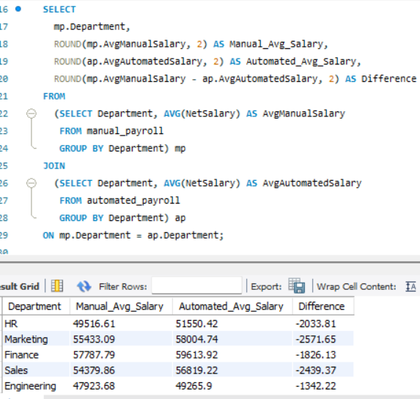
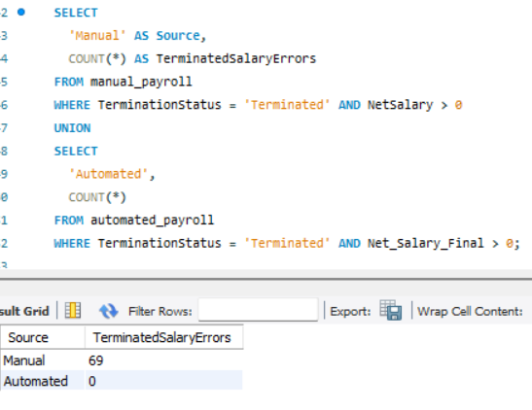
This query checks for salary payments made to terminated employees. Manual payroll shows that 69 payments were processed for terminated employees, while the automated system shows none, indicating better control and accuracy
This query highlights salary differences by department, showing that automated payroll ensures more consistent and accurate salary calculations.

Slide 6
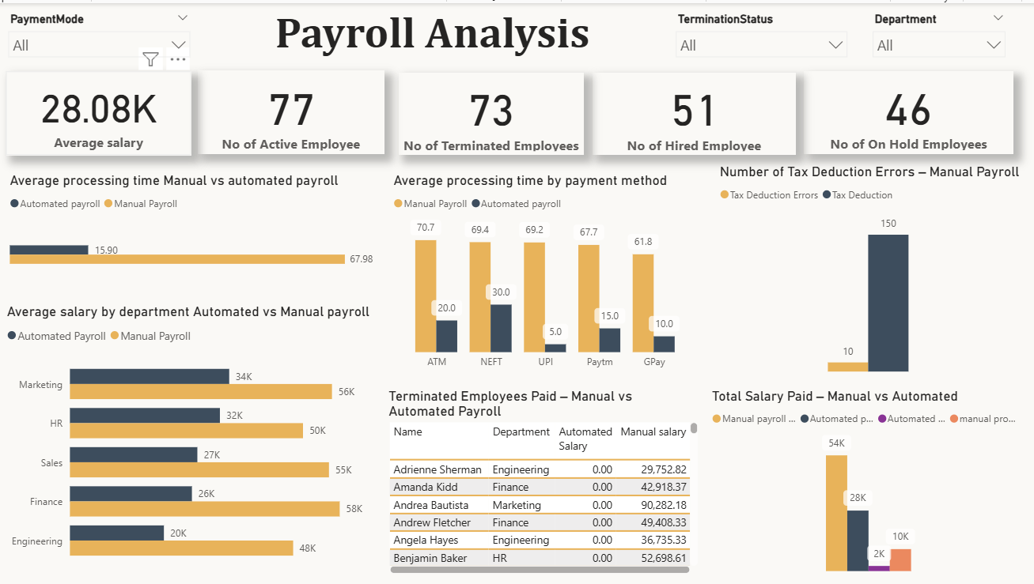

Slide 7
I have visualized the payroll data by comparing manual and automated payroll systems. The analysis highlights how automation improves accuracy, efficiency, and compliance.
Insights:
Processing Time: Manual payroll takes 68 minutes on average, while automated payroll reduces this to just 16 minutes — a 75% improvement in speed.
Tax Deduction Errors: Manual payroll had 10 errors, while ensures that there are no human errors, thus eliminating the 10 errors seen in manual payroll
Compliance Accuracy: Manual records were only 23.57% compliant, automated records were 100% error-free.
Terminated Employee Salary Errors: Manual payroll incorrectly paid 69 terminated employees, automated payroll had 0 such errors, Once the status is marked as ‘Terminated’, the payroll module excludes them from salary processing, ensuring zero salary leakage.
Salary Accuracy by Department: Automated payroll showed more consistent and realistic salaries across all departments, reducing overpayments seen in manual payroll.
Payment Mode Efficiency: Across all payment modes (ATM, UPI, NEFT, GPay, Paytm), automated payroll processes bulk transactions in real-time or scheduled batches, reducing time to as low as 5–20 minutes.
Conclusion:
Automated payroll significantly improves the overall payroll process by reducing processing time, minimizing errors, and ensuring compliance. It provides a more reliable, consistent, and scalable solution compared to manual processing.
📎 Resources & Access:
https://github.com/Gayathri1698/Payroll-gap-analysis.git

